Slide 1
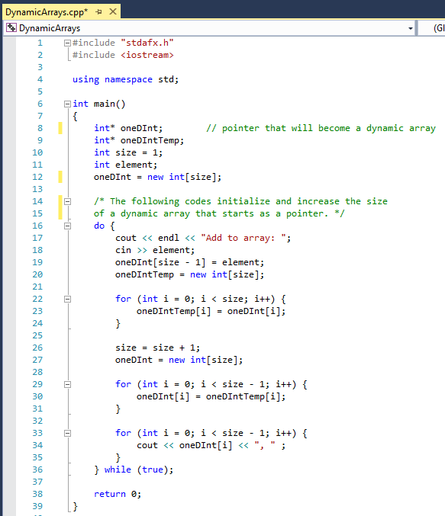
- Declared a oneDInt pointer.
- Declared a oneDIntTemp pointer.
- Initialized a size variable.
- Declared an element variable.
Pointer is saved into oneDInt. oneDInt is made into an array with the number in the size variable as an initial array size.
In the do-while loop, the program asks the user to input an int to begin initializing the elements in the 1D array.
Pointer is saved into oneDIntTemp. oneDIntTemp is made into an array with the number in the size variable as an initial array size.
The contents of oneDInt array are copied into oneDIntTemp array through a for loop.
The size variable increments by 1 to indicate that the size of the array has increased.
Lastly, the oneDInt pointer is reinitialized with the new size, and the contents of oneDIntTemp are copied back into oneDInt. Thus, this do-while loop will dynamically increase the size of the oneDInt array as more elements get added.
- Used to check the contents of the oneDInt array to show that the array is dynamically increasing in size.

Slide 2
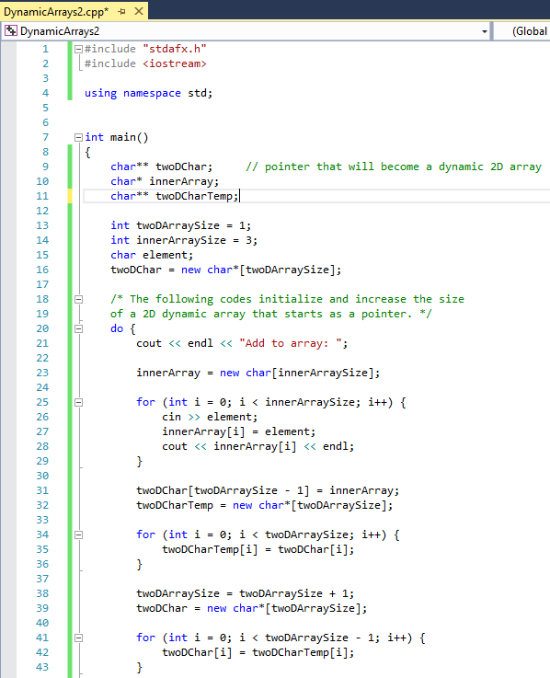
Declared a twoDChar pointer.
Declared an innerArray pointer.
Declared twoDCharTemp pointer.
Initialized twoDArraySize variable
Initialized innerArraySize variable
Declared element variable
Pointer is saved into twoDChar. twoDCar is made into an array with the int in the twoDArraySize variable as an initial array size.
Pointer is saved into innerArray. innerArray is made into an array with the int in the innerDArraySize variable as an initial array size.
The program asks the user to input a char to begin initializing the elements in the arrays inside the 2D Array. I arbitrarily made the inner arrays to be size 3.
The chars are put into an innerArray array.
Pointer is saved into twoDCharTemp. twoDCharTemp is made into an array with the number in the twoDArraySize variable as an initial array size.
The contents of twoDChar array are copied into twoDCharTemp array through a for loop.
The twoDArraySize variable increments by 1 to indicate that the size of the array has increased.
Lastly, the twoDChar pointer is reinitialized with the new size, and the contents of twoDCharTemp are copied back into twoDChar. Thus, this do-while loop will dynamically increase the size of the twoDChar array as more elements get added.

Slide 3
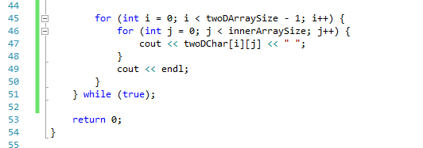
- Used to check the contents of the twoDChar array to show that the array is dynamically increasing in size.

